Slide 1
1.Project Title: Soldier Health & Position Monitoring System
SDG 3:GOOD HEALTH AND WELL BEING
Guide: Ms. U. SARITHA
Assistant Professor Department of CSE(AI&ML)
Team Members:
K.SUBHASH 247R1A6632
K.NAVEEN 247R1A6637
V.ROHINI 247R1A6610

Slide 2
2.TABLE OF CONTENT:
1. Title Page (with Guide Details)
2. Table of Contents
3. Abstract
4. Existing System and Disadvantages
5. Proposed System and Advantages
6. System Architecture
7. UML Diagrams–
Use Case Diagram
Class Diagram
Sequence Diagram
Component Diagram
Activity Diagram
8.Implementation
9. Results (Screenshots)
10. Conclusion
11. Future Scope
12. References

Slide 3
3. ABSTRACT
The Soldier Health & Position Tracking System is designed to continuously monitor the vital health parameters of soldiers such as heartbeat and body temperature, while simultaneously tracking their real-time geographical location.
This system is crucial for enhancing soldier safety during missions, enabling command units to react quickly to emergencies and dispatch help efficiently. By incorporating GPS for position data and health sensors for physiological monitoring, the system supports faster decision-making in critical situations.

Slide 4
4. EXISTING SYSTEM
DISADVANTAGES
Manual Health Monitoring Soldiers’ health conditions are checked manually through periodic communication, with no automated or continuous monitoring of vital parameters.
Limited Location Tracking Exact real-time position of soldiers is not continuously available; location updates depend on verbal reports or delayed communication.
Slow Emergency Response In case of injury or health issues, command centers receive information late, increasing the time required to send medical or rescue support.
No Real-Time Health Monitoring Soldiers’ vital parameters are not monitored continuously, making it difficult to detect health issues at an early stage.
Inaccurate or Delayed Location Information Soldier position details depend on manual reporting, which may be delayed or incorrect during combat situations.
Slow Emergency Response Lack of instant information increases the time required to provide medical or rescue assistance.

Slide 5
5. PROPOSED SYSTEM
ADVANTAGES
The proposed system integrates sensors and communication modules to automate monitoring and reporting:
GPS Module (e.g., Neo-6M) provides continuous latitude and longitude updates.
Heartbeat Sensor measures the pulse rate.
Temperature Sensor tracks body temperature.
GSM Module (e.g., SIM800) sends the collected data to a remote command centre.
Microcontroller (e.g.,Arduino) reads sensor outputs, processes data, and manages communication.
Once deployed, the system transmits the soldier’s health metrics and GPS coordinates in real time, enabling rapid response if any parameter crosses a critical threshold.
Real-Time Monitoring: Soldiers’ location and health status are updated continuously.
Faster Emergency Response: Command can dispatch medical or tactical help immediately.
Improved Safety: Immediate alerts when health vitals exceed normal thresholds.
Remote Communication: Data shared through GSM network without manual intervention.

Slide 6
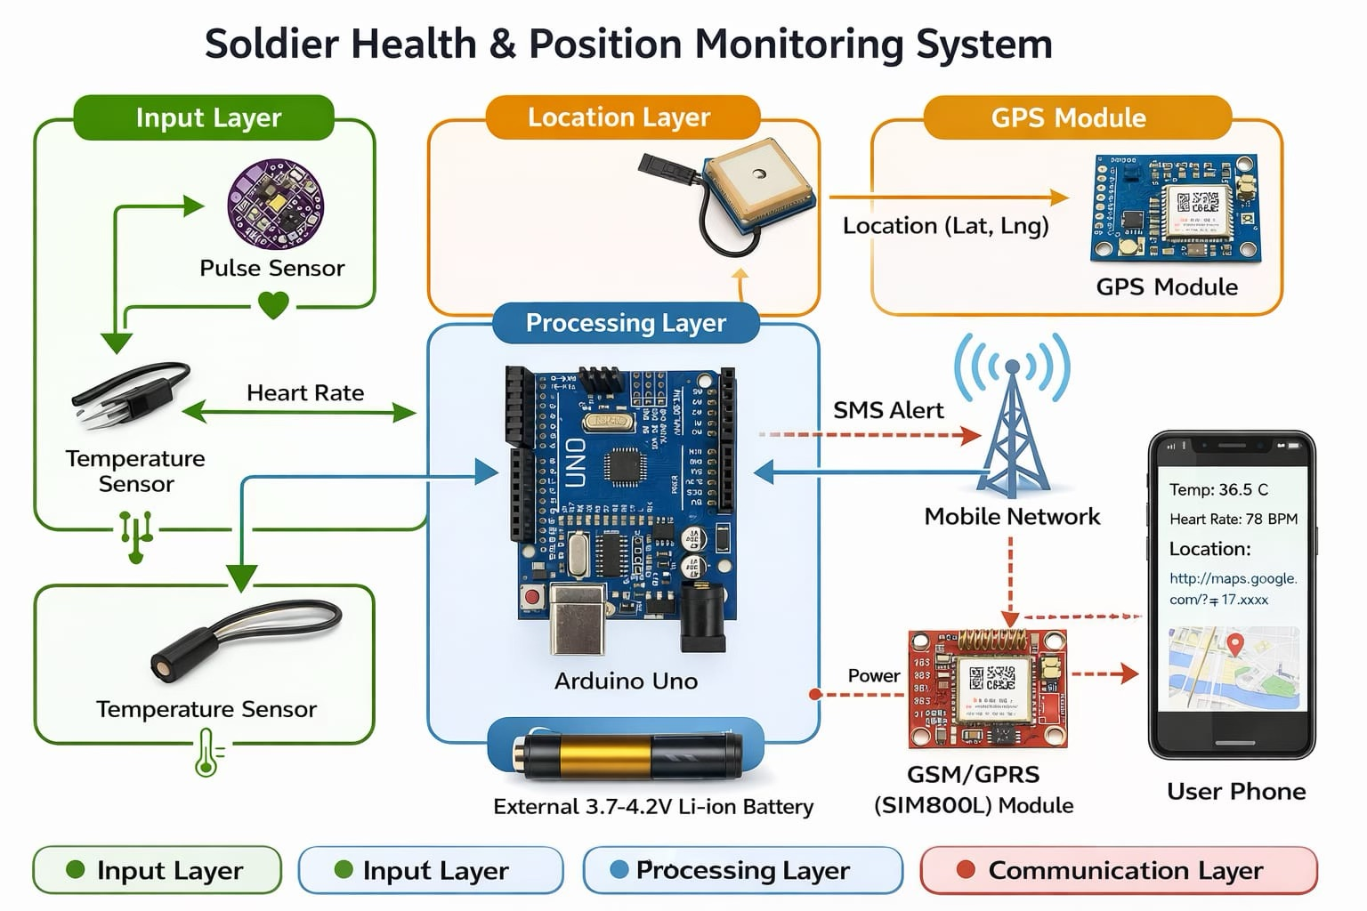
6. SYSTEM ARCHITECTURE

Slide 7
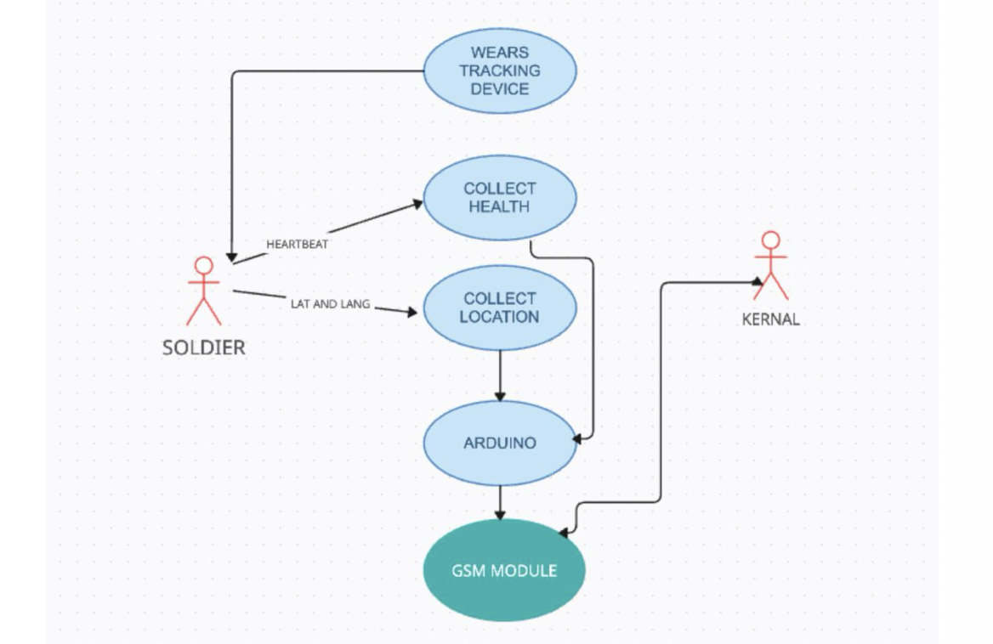
7. UML DIAGRAMS
USE CASE DIAGRAM

Slide 8
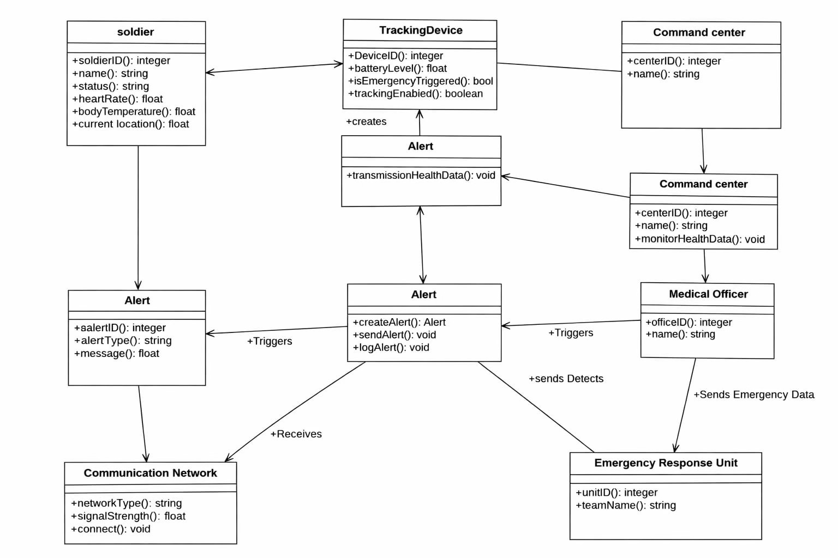
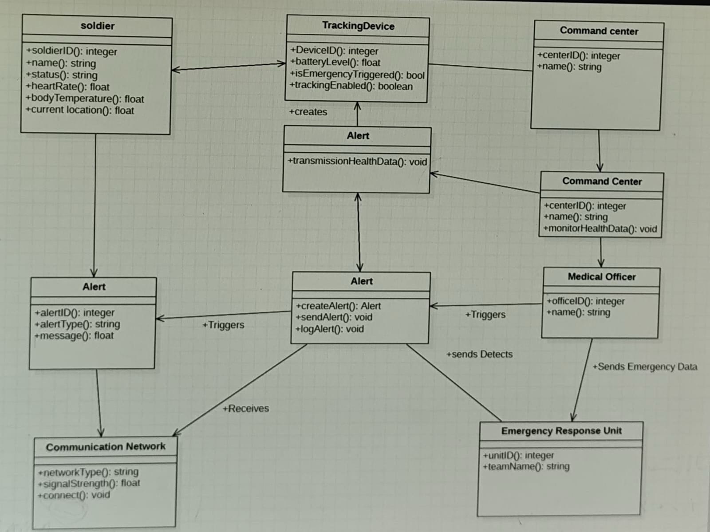
CLASS DIAGRAM

Slide 9
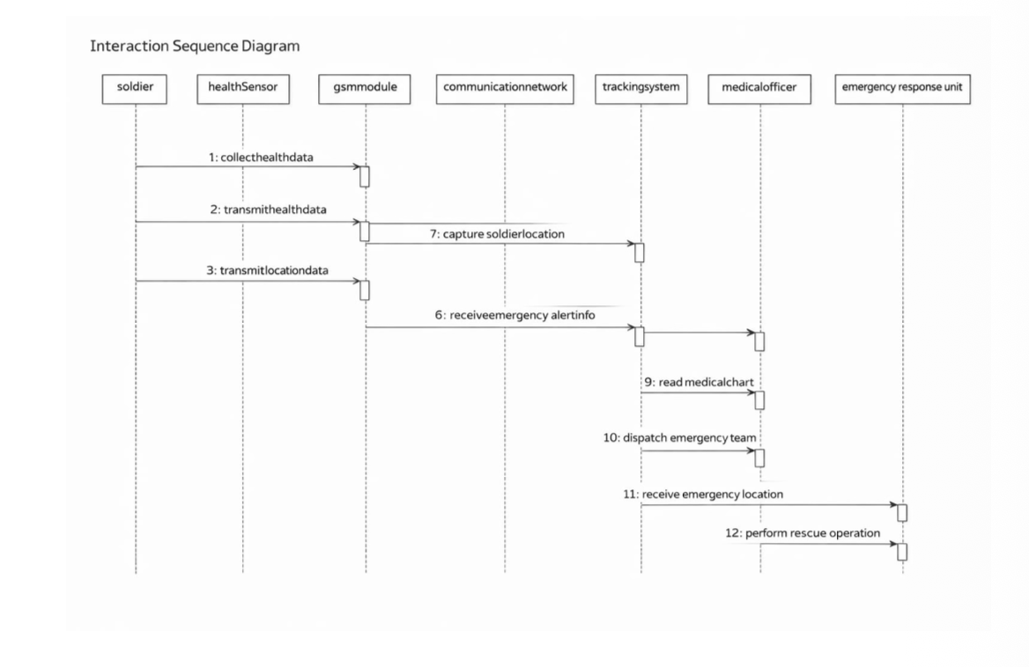
SEQUENCE DIAGRAM

Slide 10
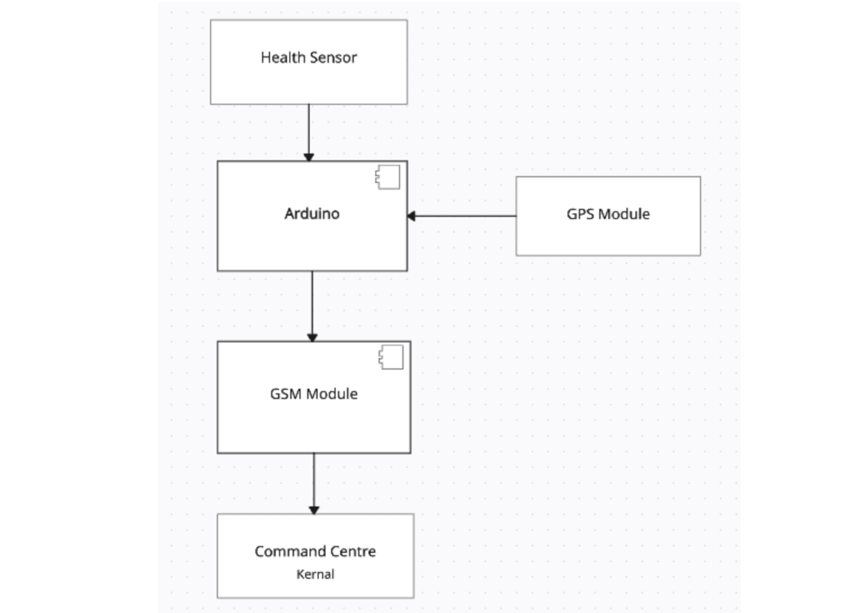
COMPONENT DIAGRAM

Slide 11
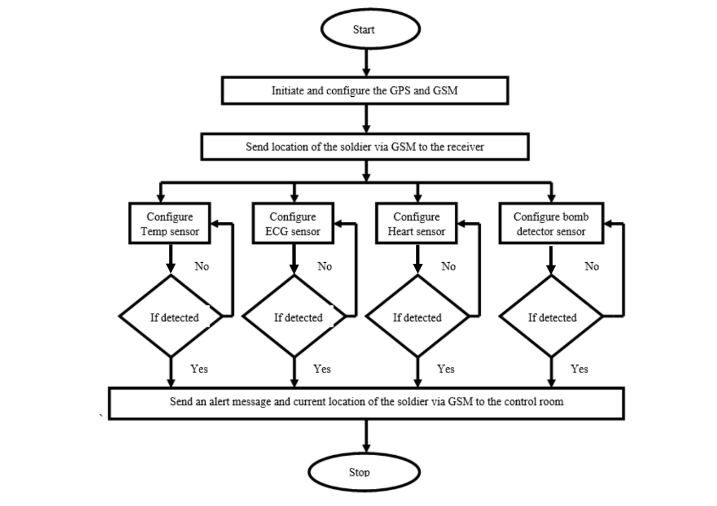
ACTIVITY DIAGRAM

Slide 12
8. IMPLEMENTATION
1. The implementation phase involves building the Soldier Health and Position Tracking System by integrating hardware components like sensors, GPS, microcontroller, and communication modules. Sensors collect health data (heart rate, temperature), while the GPS tracks the soldier’s location. The microcontroller processes this data and sends it to a monitoring station via GSM or RF. The system is tested to ensure proper communication and reliable performance, providing accurate health and location information during missions.
2. Testing is performed during the implementation phase to ensure that all components work correctly and communicate effectively with each other. Proper integration of hardware and software ensures that the system operates reliably and provides accurate information during military missions..

Slide 13
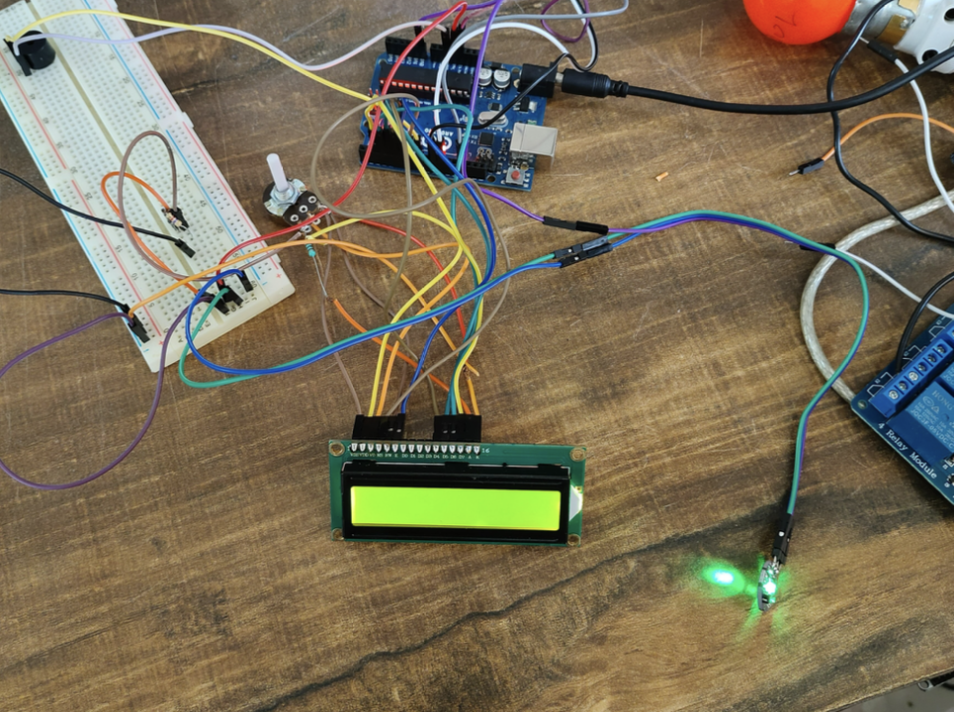
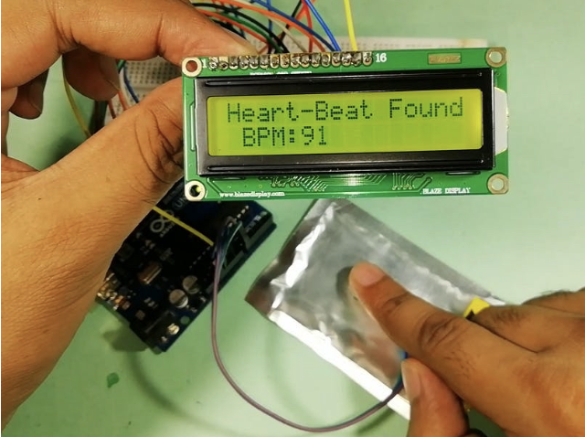
9. RESULTS

Slide 14
10. CONCLUSION
The Soldier Health & Position Tracking System bridges a critical gap in battlefield operations by providing automated real-time tracking of both health vitals and geographical position. It enhances soldier safety, reduces response time in emergencies, and improves operational awareness for command units. This project also demonstrates the effective integration of embedded hardware and communication technologies for life-critical applications
Future Scalability The system can be further enhanced by integrating advanced sensors, IoT cloud platforms, and AI-based analytics to improve prediction, monitoring accuracy, and overall mission effectiveness.

Slide 15
11. FUTURE SCOPE
Although the Soldier Health and Position Tracking System provides an effective solution
for monitoring soldiers health and location, there are several opportunities for further
improvement and development
Future Enhancements of Soldier Health and Position Tracking System
Proposed Improvements and Advancements
System Enhancement and Development Scope
Future Scope of the System (most commonly used in reports)
Advanced Features and Future Upgrades

Slide 16
12. REFERENCE
https://ieeexplore.ieee.org/document/9754096
https://tinyurl.com/yrhe4mj9
https://nevonprojects.com/soldier-health-position-tracking-system/

